Slide 1
MONEY PROBLEMS? DON’T KNOW WHAT TO DO? WE CAN HELP!
$
$
Fort Lauderdale and Miami, Florida
October 30, 2021, from 10:30 to 17:00 (EST)
A Joint Program of:
The Business Law Section of the Florida Bar
Mission United Broward
Legal Services of Greater Miami

Slide 2
PROGRAM STRUCTURE
KEYNOTE BY BRIGADIER GENERAL & U.S. BANKRUPTCY JUDGE, THE HONORABLE CHUCK WALKER.
A POWER POINT ON IMPROVING YOUR FINANCIAL HEALTH.
INDIVIDUAL MEETINGS WITH ATTORNEYS READY TO HELP IDENTIFY YOUR PRIORITIES AND ANY NEED FOR FURTHER LEGAL REPRESENTATION.

Slide 3
WE WILL HELP YOU . . .
Identify the financial issues that you need to address;
Prioritize those issues through goal setting;
Provide tools to reach your goals;
Provide some legal help to address your financial issues when you’re ready.
This Photo by Unknown Author is licensed under CC BY

Slide 4
BEFORE WE START . . .
YOU ARE NOT ALONE. THREE out of FOUR of us say our finances cause stress on a monthly basis.
THEY DIDN’T TEACH THIS IN SCHOOLS. Our society does not do a good job teaching the basics for sound financial fitness.
IT’S NOT JUST ABOUT MONEY. Stress over financial issues has significant negative effects on both mental and physical health and your relationships with others.
KEEP IT SIMPLE & START WITH SMALL STEPS.
This Photo by Unknown Author is licensed under CC BY-NC

Slide 5
BUDGETING
Insert SNL Video

Slide 6
FINANCIAL BUILDING BLOCKS
This Photo by Unknown Author is licensed under CC BY
Your financial health is partially determined by comparing the amount of your INCOME to your EXPENSES (both monthly and periodic). This calculation is often called your CASH FLOW.
INCOME = money from various sources including wages, veterans and other government benefits, retirement, etc.
EXPENSES = money spent on:
1) BASIC NEEDS;
2) FUTURE NEEDS; and
3) WANTS.

Slide 7
Determining the Amount of Your Current Income and Expenses - BUDGETING
The best tool to determine your current CASH FLOW (i.e., your INCOME minus your EXPENSES) is a simple BUDGET. WHAT’S A BUDGET?
https://www.millionstories.com/media/Budgeting?video=35&series=2In
The primary way to improve your financial situation is to either (or both):
increase your INCOME, or reduce your EXPENSES
We will give you some ideas on how to do both.

Slide 8
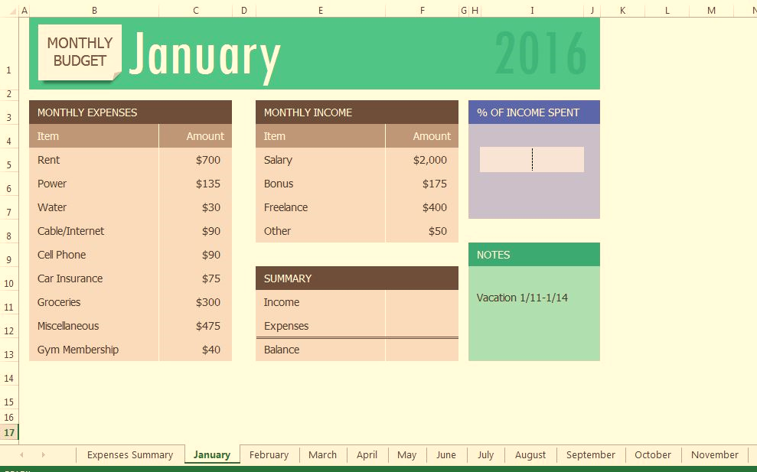
KEEP IT SIMPLE. BUDGETING DOESN’T HAVE TO BE DIFFICULT OR TIME CONSUMING
Write down everything you spend for three months to determine your expenses. Everything! Even that bag of potato chips or cup of coffee.
Also, remember to add upcoming lump-sum expenses (like taxes and insurance) to the budget or save for them.
There are many ways to budget. Find a way you can and will budget every month.

Slide 9
Budgeting Apps
Some people find it easiest to track expenses on their phone. Free options for budgeting apps and tools include:
Mint
Goodbudget
Pocketguard
Honeydue
Google Sheets

Slide 10
SavingS
Budgeting allows you to save and budgeting sets you up for the future.
We all need funds for a rainy day. How do you make that happen?

Slide 11
LEARN. HOW. TO. SAVE!! WHY? BECAUSE LIFE HAPPENS . . .
47% of us report that we could not come up with $400 if we need to without selling something, increasing debt, or borrowing. Become part of the other 53%.
Start small to get into the habit. Your ultimate goal should be to save 10-20% of your income.
WHY SAVE? Emergencies, rent deposit, down payments on a car or house, or even a “want.”

Slide 12
SOME WORDS ON BANK ACCOUNTS . . . (1/2)
If your banking history is strong, you have more options to shop for the best bank or credit union to place your money. Credit unions often have lower fees on accounts.
If you want to check your banking history and review it for errors go to www.cfpb.gov/askcfpb/2035. See also www.cfpb.gov/askcfpb/2029 for steps on disputing errors.
Comparison shopping for fees and charges is a good idea to see how you can save the most money.
If your banking history is poor (e.g., NSF checks, unpaid fees), look for a bank or credit union that has either a “second chance” or checkless checking account option. This option does not build credit.
This Photo by Unknown Author is licensed under CC BY-SA

Slide 13
SOME WORDS ON BANK ACCOUNTS . . . (Continued; 2/2)
Mission United Broward and Miami Legal Aid have established relationships with several Veteran friendly banks, including Navy Federal, USAA, Chase, and Wells Fargo.
If none of those options are available you may have to start with using a pre-paid card. Be aware of fees charged, including monthly fees or withdrawal fees, in choosing this option and shop around. Pre-paid (i.e., “secured”) credit cards help you rebuild your credit.
This Photo by Unknown Author is licensed under CC BY-SA

Slide 14
CREDIT AND CREDIT REPORTS
Get Your Credit Report Now! And Again Each Year from all three of the reporting bureaus (Experian, Equifax, and TransUnion) www.annualcreditreport.com. It is FREE once a year. Don’t use private companies that advertise a “free” credit report as they sell your information.
Dispute any errors with each reporting agency. See Handout.
Look for signs of identity theft (e.g., social security number, accounts you did not open, wrong addresses or employers, etc.). If you find signs of ID theft, file a police report.
This Photo by Unknown Author is licensed under CC BY

Slide 15
YOUR CREDIT SCORE IS IMPORTANT TO YOUR FUTURE FINANCIAL HEALTH
65% of
Total Score =
Amount owed
+
Payment
History
Your FICO credit score is a 3-digit number between 300 and 850. The higher the number the better.
Banks, other sources of borrowing (lenders), employers, and landlords may use your credit score to assess your credit risk and set terms like interest rates on loans, down payments, or deposit requirements.

Slide 16
REPAIRING YOUR CREDIT- IDENTIFYING AND PRIORITIZING YOUR DEBTS
Because of the way your credit score is determined, dealing with your DEBTS should be a top priority.
First, Identify your DEBTS using your:
Credit Report;
Credit card statements and billing statements;
Court orders;
www.studentaid.gov/fsa-id/sign-in/landing for public student loan statements and look at monthly statement for private student loans;
Tax transcripts for past due IRS taxes (https://www.irs.gov/individuals/get-transcript);
Loan agreements or leases (car, house, apartment).
Second, Prioritize your DEBTS by the RISKS of non-payment. Some debts like Court ordered fines, certain taxes, and certain child support debts may be a priority because of the risks of non-payment, i.e. fines, jail, etc.
See Handout for more detail and worksheets.
This Photo by Unknown Author is licensed under CC BY

Slide 17
DEALING WITH DEBT

Slide 18
SOME IDEAS FOR DEALING WITH DEBT
For court-related debts, explore payment plans, reductions, and waivers available under law.
For other debts, negotiate a payment plan or debt reduction and/or a decrease in interest rate. If these debts are in collection, talk to a lawyer to understand the potential impacts of settlement like tax issues, restarting the clock on old debts, best means to address the debt, etc. Contact Legal Aid for help!
Informal non-profit credit counseling agencies exist that may assist or advise you for a fee. www.nfcc.org/agency-locator. Avoid for-profit businesses that promise more than they deliver. Don’t do an overall payment plan unless you know it will help your situation.
Bankruptcy may be an option . . . (See Slides and Handout)
This Photo by Unknown Author is licensed under CC BY-SA-NC

Slide 19
Legal Aid Resources
Depending upon your financial situation, you may wish to consult with an attorney at some point in the future. Here are some additional resources for pro bono (free) legal aid:
LawHelp.org is the gateway to legal aid providers in every state.
FloridaLawHelp.org is the gateway to Florida legal resources.
Florida Rural Legal Services (provides high-quality civil legal services to address the special legal needs of migrant and seasonal farmworkers throughout Florida.)
Free Legal Answers – This is a virtual legal advice clinic where you can ask a question and get an answer.

Slide 20
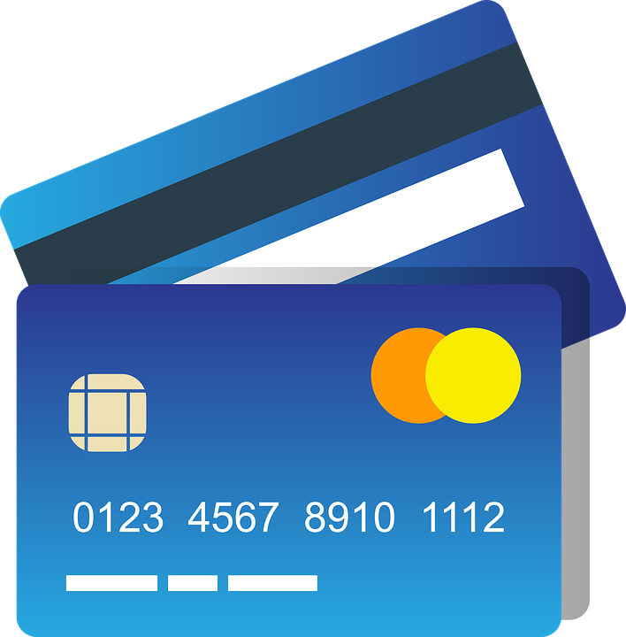
USE CREDIT CARDS RESPONSIBLY TO IMPROVE YOUR CREDIT RATING
Rebuild your credit and improve your credit rating by responsibly using a credit card to pay regular monthly expenses.
You may need to start with a “secured card” (i.e. , a credit card with a limit that is tied to a restricted deposit of funds).
Shop and compare annual fees, late fees, balance transfer fees, over balance fees, cash advance fees, and interest rates. (https://www.nerdwallet.com/compare/credit-cards)
The cardinal rule is to PAY YOUR BALANCE IN FULL EVERY MONTH! Then you will not pay any interest.
DON’T BUY THINGS YOU CANNOT AFFORD WITH YOUR CREDIT CARD.
If you cannot follow these rules, stick to a secured card until you can.
PAY IN FULL EACH MONTH!
READ THE FINE PRINT!
DON’T BUY STUFF YOU DON’T NEED!
BUILD YOUR CREDIT!
This Photo by Unknown Author is licensed under CC BY

Slide 21
REPAYING LOANS MAY ALSO IMPROVE YOUR CREDIT SCORE BUT ONLY IF YOU PAY ON TIME!
Before signing loan documents, fully understand your loan terms, including:
Upfront loan fees
Interest rate(s) – does the rate change?
Repayment schedule
Default Provisions
Total cost of loan over its term
Any co-signor requirements
Read EVERYTHING before you sign!
This Photo by Unknown Author is licensed under CC BY
SHOP FOR THE BEST LOAN TERMS!

Slide 22
COMMENTS ON USING STUDENT LOANS FOR FUTURE EDUCATION/TRAINING COSTS
DO THESE THINGS IN THIS ORDER . . .
Research ways to minimize costs – public school, junior college, shared housing
Work and save money before starting, if you can.
Maximize use of fund sources other than student loans like grants, scholarships, and available veteran’s benefits.
Apply for federal student loans before considering private loans. Remember to look at the loan terms and shop around.
STUDENT LOANS SHOULD BE USED LAST AND ONLY FOR ABSOLUTE NECESSITIES!
ONLY USE PRIVATE STUDENT LOANS AS A LAST RESORT.
This Photo by Unknown Author is licensed under CC BY
TOTAL AMOUNT OF STUDENT LOANS SHOULD NOT BE MORE THAN THE SALARY YOU EXPECT TO EARN IN YOUR FIRST YEAR

Slide 24
DEALING WITH STUDENT LOANS YOU MAY ALREADY HAVE (1/2)
Find out whether your student loans are federal or private and who is the servicer of the loan. If it is a federal loan it should be listed and the servicer handling your account can be located at www.studentaid.gov.
For government loans there are different programs that are available depending on various factors, including your current income and ability to pay (e.g. Income Driven Repayment, Public Service Loan Forgiveness, Income-Based Repayment, Pay as You Earn, and Revised Pay as You Earn). You should understand the requirements of these programs and the consequences, including tax consequences for loan forgiveness, before signing up.

Slide 25
DEALING WITH STUDENT LOANS YOU MAY ALREADY HAVE (Continued;2/2)
For most private loans you will have to try and reach an agreement with the lender for a repayment plan.
If you have been designated by the VA as Totally and Permanently Disabled based on injuries you suffered during your service, you may be eligible for student loan forgiveness under the TPD Discharge.
You can find military specific information that applies to veterans and active military student loan borrowers at: https://files.consumerfinance.gov/f/documents/201604_cfpb_servicemember-student-loan-guide.pdf

Slide 26
DEBT COLLECTION
Know Your Rights!
And Know What
Creditors’ Rights Are.

Slide 27
KNOW AND PROTECT YOUR RIGHTS IN DEBT COLLECTION! (1/3)
When contacted, find out 1) the name, address, and phone number of the debt collector; 2) the debt amount + fees and costs added; 3) what the debt is for and the date it was incurred; 4) the name of the original creditor; & 5) any additional info to assess whether you owe the debt.
DO NOT AGREE DURING THE CALL TO PAY THE DEBT.
If by phone, ask that they contact you in a writing that includes the legally required information.
NOTE, sometimes you must respond within 30 DAYS to request additional info and to dispute a debt. Sample letters to debt collectors can be found at https://www.consumerfinance.gov/consumer-tools/debt-collection/
You can keep notes using pencil and paper or on your phone, whatever works for you.
KEEP WRITTEN NOTES OF CONVERSATIONS INCLUDING DATES, NAMES, AND SUBSTANCE. KEEP IN A FILE WITH CORRESPONDENCE

Slide 28
KNOW AND PROTECT YOUR RIGHTS IN DEBT COLLECTION (Continued; 2/3)
Consumers are protected under the Fair Debt Collection Practices Act (FDCPA) against certain actions by debt collectors.
UNDER THE FDCPA, A DEBT COLLECTOR MAY NOT:
Call repeatedly to harass or abuse you.
Use obscene language, threaten bodily harm, or arrest.
Make a false or misleading statement about the debt.
Publish your name for not paying the debt.
Lie to you.
Threaten legal action unless the creditor intends to
take you to court.
This Photo by Unknown Author is licensed under CC BY-SA-NC

Slide 29
KNOW AND PROTECT YOUR RIGHTS IN DEBT COLLECTION (Continued; 3/3)
VIOLATIONS OF THE FDCPA MAY RESULT IN THE CFPB TAKING REGULATORY ACTIONS OR PRIVATE ATTORNEYS SEEKING STATUTORY DAMAGES AND ATTORNEYS’ FEES.
To make a complaint to the CFPB visit www.cfpb.gov/complaint.
This Photo by Unknown Author is licensed under CC BY-SA-NC

Slide 30
SUMMARY OF SOME LIMITS ON COLLECTION AND MILITARY SPECIFIC PROTECTIONS (1/2)
Generally, payments of benefits by the VA are exempt from general creditors’ claims and may not be attached, levied, or seized. The source of the payment matters. Some military retirement pay from DOD may be subject to garnishment.
One important exception to the “exempt” rule is that if you owe child support, spousal support, or have been ordered to divide property by a court, the creditor may be able to garnish retirement pay up to the maximum amounts provided by state and federal law.
Disability compensation generally is not subject to garnishment except to the extent that you waived retirement pay to receive disability compensation.

Slide 31
SUMMARY OF SOME LIMITS ON COLLECTION AND MILITARY SPECIFIC PROTECTIONS (Continued 2/2)
Some VA overpayments may also be recovered from military/retirement benefits unless you obtain a waiver from the VA showing that recovery “would be against equity and good conscience.”
NOTE: You may also request a debt waiver on loans guaranteed, insured, or made by the VA on the same basis following default and property loss. There are time limits for requesting such waivers.
If any judgments were obtained during your period of active service, you should see if the lawsuits filed violated your rights under the Servicemembers Civil Relief Act (“SCRA”) and the Military Lending Act (“MLA”), which may help you dispute some or all the debt.
The SCRA’s benefits and protections include a six percent interest rate cap on financial obligations that were incurred prior to military service, 50 U.S.C. § 3937; the ability to stay civil court proceedings, id. at §§ 3931, 3932; protections in connection with default judgments, id.; protections in connection with residential (apartment) lease terminations, id. at § 3955; and protections in connection with evictions, mortgage foreclosures, and installment contracts such as car loans. Id. at §§ 3931, 51, 53, 55-56.
The MLA provides a 36% interest rate cap, precludes waivers of legal rights like arbitration, precludes mandatory allotments and prepayment penalties.

Slide 32
BANKRUPTCY
Bankruptcy is an option, but it should not be your first option. Bankruptcy provides you with the opportunity to resolve certain debts and give you a fresh start and an almost clean slate.

Slide 33
BANKRUPTCY – SOME BASICS (1/2)
Bankruptcy stops creditors’ calls, lawsuits, enforcement actions upon filing the paperwork through something called the automatic stay.
Bankruptcy generally discharges, or wipes clean, most types of debt (credit cards, personal loans, past due rent, most civil judgments, utility bills) for the “honest but unfortunate debtor.”
Some debts, however, may not be discharged like child/spousal support, most student loans, and some taxes.
The two most common types of bankruptcy individuals use are:
LIQUIDATION under CHAPTER 7, or
REPAYMENT PLANS (usually for 3 to 5 years) under CHAPTER 13 for debtors with regular income.
The United States Bankruptcy Court for the Southern District of Florida (www.flsb.uscourts.gov) has two helpful programs that you may want to investigate:
Student Loan Modification and Mediation Program
Mortgage Modification Mediation
The Chapter 13 discharge is broader than the Chapter 7 discharge, i.e. more debts are discharged/wiped-clean in Chapter 13 than in Chapter 7
Bankruptcy Stigma? Fear of Bankruptcy? Don’t let either hold you back if bankruptcy is right for you.

Slide 34
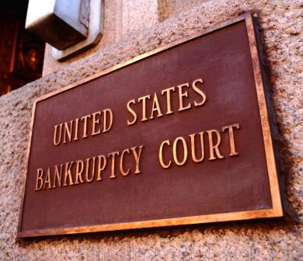
BANKRUPTCY BASICS (Continued; 2/2)
It’s important to know how bankruptcy will personally impact you before you file because there are limits on how often you can obtain a bankruptcy discharge, e.g., 8 years between Chapter 7 cases.
Do not file bankruptcy if you are in a situation that the debt is still accumulating. For example, if you are in the middle of treatment and medical bills are ongoing.
Also, do not use bankruptcy if you are “judgment proof.”
You are only receiving income that cannot be taken by creditors.
You only have “exempt” assets (homestead; car valued at $1,000 or less; less than $1,000 or $5,000 if no home)
The Bankruptcy Code changed to exclude most types of military related disability pay from “current monthly income.” This generally means you cannot be forced to use this money to pay creditors in a Chapter 13 case with personal property.
To learn more about bankruptcy, meet with an attorney.
Visit www.flsb.uscourts.gov for additional bankruptcy resources.

Slide 35
SOME FINAL THOUGHTS

Slide 36
SOME ADDITIONAL MEANS FOR IMPROVING YOUR FINANCIAL SITUATION
Do you have a service-related disability? Have you applied for compensation from the VA? Has the VA denied your claim or is not paying you as much as you think you rate?
Did you serve during a time of war? Have you filed for a VA pension? Has the VA denied your pension claim?
Is any of your medical debt a result of injuries or disabilities related to your military service? Have you tried to have the VA cover the costs of that medical care (even if it wasn’t provided by the VA)?
Is the characterization of your discharge precluding you from getting benefits like disability compensation or the GI Bill? Have you filed to upgrade your discharge with the Dept of Defense? Have you applied to the VA to find your service Honorable for VA purposes so you can receive treatment and/or benefits?
If any of the above applies to you, you can speak with the lawyers we have made available to see if further representation could lead to an improvement in benefits or your financial situation.

Slide 37
A PLACE TO START FINANCIAL GOAL SETTING
What is the one thing I want to change in your finances?
Set a financial goal that interests you.
Write that goal down.
Consider sharing the goal with someone who will help or hold you accountable.
Make a plan that identifies resources you can use to meet your financial goal.
Know the strategies that work best for you.
Set a deadline to complete the goal.
Be flexible as necessary by adjusting as you go when you must so you can achieve the goal.
This Photo by Unknown Author is licensed under CC BY

Slide 38
“START WHERE YOU ARE, USE WHAT YOU HAVE, DO WHAT YOU CAN.” Arthur Ashe
Freedom to Thrive:
Love & Belonging
Freedom from Fear:
Feeling Safe & Secure
Freedom from Want:
Survival
Freedom to Grow: Self-Improvement & Achievement
Freedom to Progress: Higher Purpose
Self-fulfillment
Self-esteem, Education
Family, Acceptance, & Understanding
Physical & Emotional Safety
Shelter, Food, Clothing

Slide 39
A SPECIAL THANKS TO:
THANKS TO ALL OF OUR VOLUNTEERS AND PARTICIPANTS!
Judge Mary Jo Heston
Judge Charles Walker
The National Conference of Bankruptcy Judges
American Bankruptcy Institute’s Veterans and Servicemembers Task ForceThe CARE Program – www.care4yourfuture.org
The Handout accompanying this presentation includes some forms and additional information that may help you move forward towards a better financial situation.
Below are some additional resources that include more detail on some of the topics we covered today:
CFPB website www.consumerfinance.gov (covers numerous financial topics).
https://veterans.abi.org/resources and https://veterans.abi.org/faq
(information on military/veteran specific issues related to collection and bankruptcy).

